Slide 1
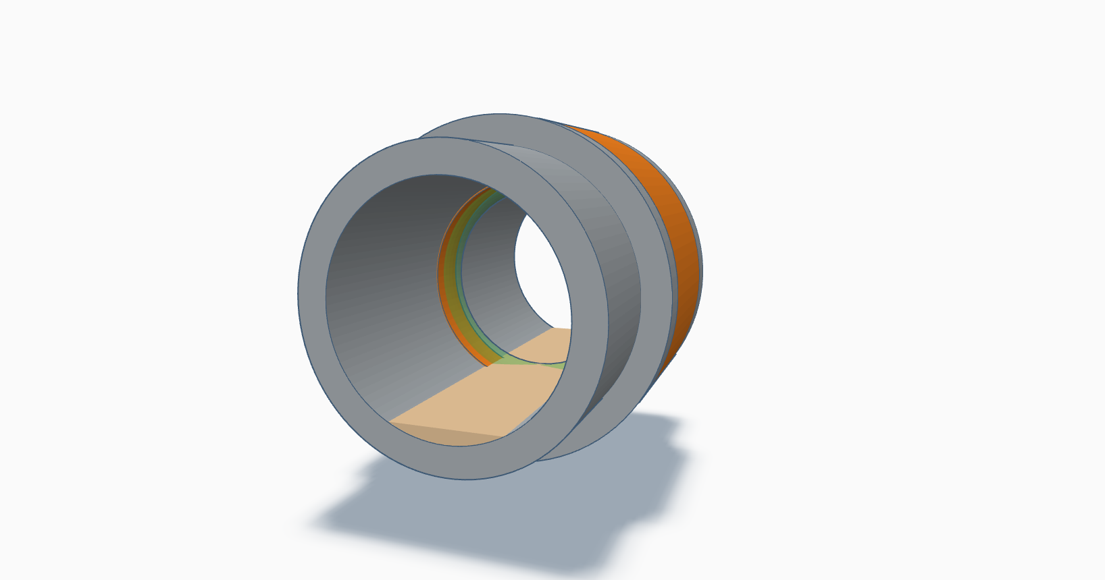
sensing
region
sensor
flange
deposit

